Slide 1

Viva Presentation
Procedural Generation of Realistically Scaled Planets
Adam Hurst
Notes:
Welcome to my presentation
My name
Say name of project

Slide 2
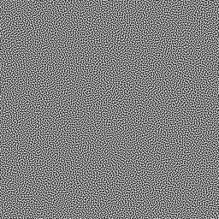
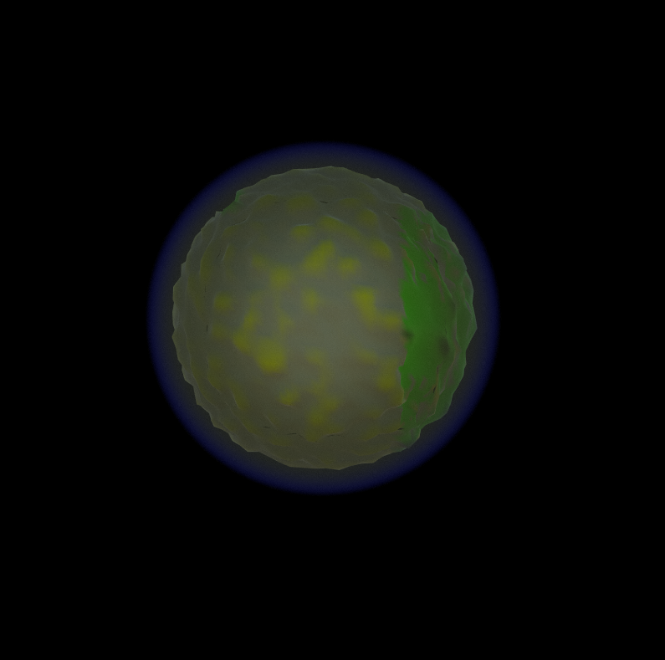
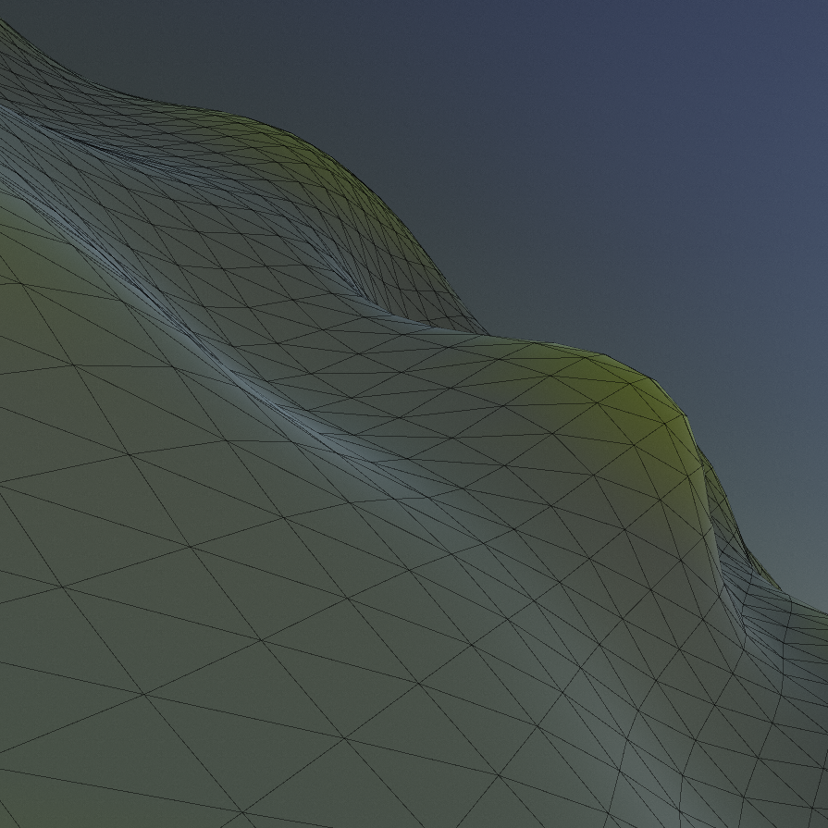
Topics
Context
Research
Design
Product Demonstration
Evaluation and Conclusion
Notes:
Talk about all the topics for today
Context
What the project is and where it stands within research and the industry
Why is this thing important
Research
Brief summary of the areas that were researched
Design
Information on what was design and implemented
Discuss the making of the actual product
Product demo
Show-off a demonstration of the package and the application
Evaluation
Talk about how the product ended up working
Show some graphs and close ups of the product
Conclusion
What could be done better, what has been learened

Slide 3

Context
Notes:
To start I'm going to discuss the context of this project within research and where it lies within the industry
The trend of procedural generation has been increasing in games within recent years
Specifically, within the sci-fi genre, with the use of procedurally generated planets
Some games feature this as a suplemnatary feature (space engineers, elite dangereous)
Some games feature this as a main game play feature (no mans sky)
PCG allows for developers to quickly and easisly generate game worlds, and spend more time on developing gameplay mechanics

Slide 4
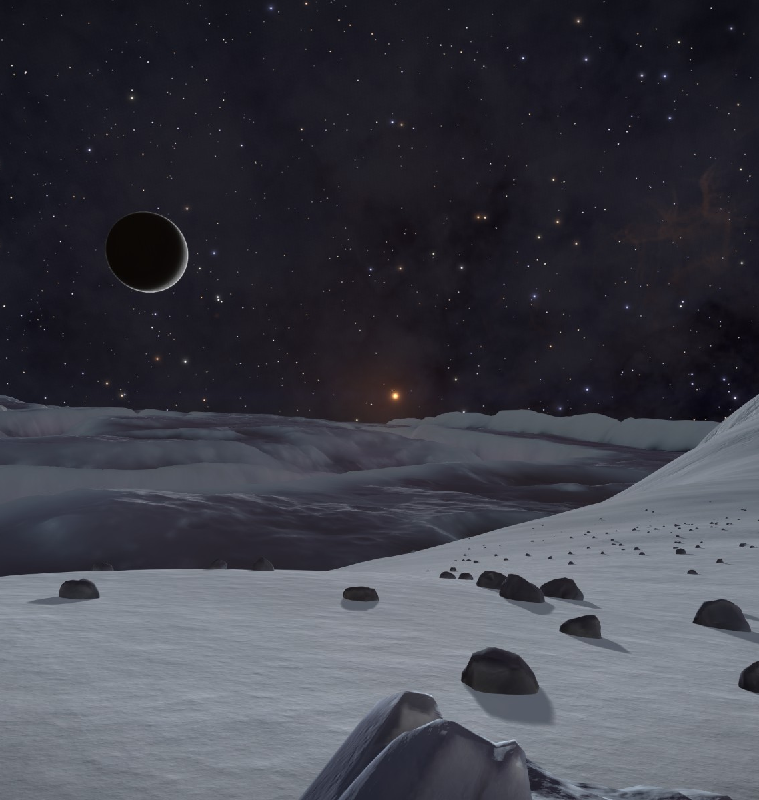
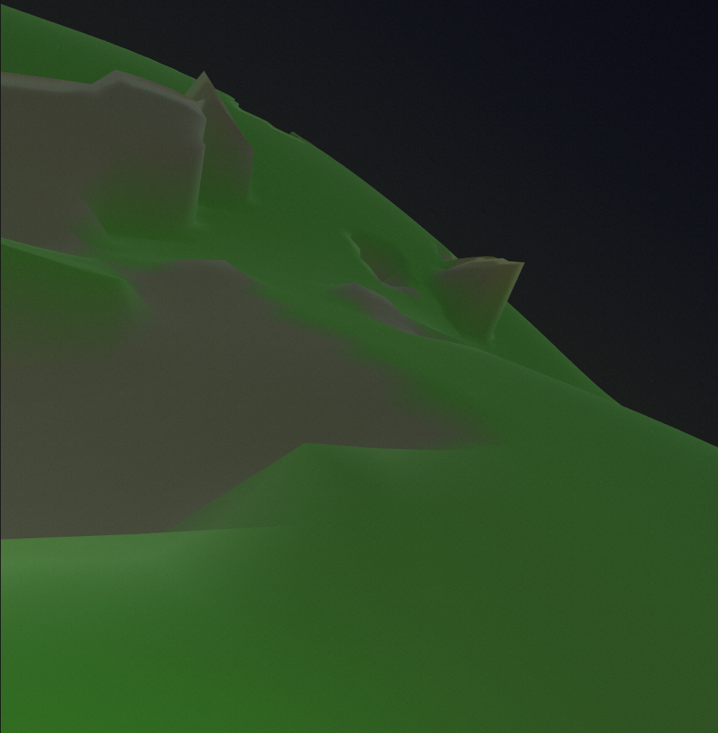
Notes:
Some problems with these implemented approaches
Inaccessible to other developers
Not to a realistic scale
Aims and objectives of this project
Wanted to create a system that was easy and accessible for developers to use
Create realistic scaled planets

Slide 5
Research
Notes:
Instead of covering the research as I did in my last presentation, I'm just going to do a brief summary a refresher
Will go into more detail on some sections when talking about their design and implementation
The main topics of research were
Mesh generation
How to generate the actual mesh of the planet for the terrain to go on to
How to generate the verticeis of a sphere, that is well distributed and accurate
Level of detail systems
Find a way to allow for changing the mesh’s detatil and resolution depending on the camera’s location
Crucial for the scale that is being targeted
Floating point precision errors
The issues that arise when floats becomes so large that they do not have enough decimal precision
Find ways to fix / alleviate these issues
Procedural terrain generation
How to turn the mesh into something that resembles terrain
Includes:
Noise
Heightmaps
Etc.
Atmospheric rendering
How to create a simulated atmosphere for the planets
Another layer of realism and immersion
Rayleigh and mei scattering methods

Slide 6
Design
Notes:
This section will talk about each of the components that was created, and how they were designed
Design philosophy
Took a very iterative approach, so many great theorists
One approach was tried and tested for its effectiveness
This was repeated until an ideal method was found
Take a user friendly approach
Use of unity
Acceible
Scriptable obejects for the purpose of non-code configuration

Slide 7
Mesh Generation
Terrain Generation
Level of Detail
Atmospheric Rendering
Main Areas of Development
Notes:
Here are the 4 main areas of development within this project, these are:
Mesh generation
The generartion of the sphere mesh
Terrain generation
Creating the distinct biomes
Morphing the mesh to create terrain
Atmospheric rendering
Create the atmosphere
Level of detail systems
Increase/Decrease the mesh resolution for performance and quality reasons

Slide 8
Mesh Generation
For f faces in cube:
AxisA = GetUpOfNormal(Normal)
AxisB = Cross(Normal, AxisA)
For (y < MeshResolution)
For (x < MeshResolution)
Iterator = x + y * MeshResolution
Percent = (x, y) / (MeshResolution - 1)
PointOnUnitCube = Normal + (Percent.x – 0.5) * 2 * AxisA +
(Percent.y – 0.5) * 2 * AxisB
PointOnUnitSphere = Normalize(PointOnUnitCube) * Radius
Vertices[Iterator] = PointOnUnitSphere
If x != MeshResolution - 1 And y != MeshResolution -1
Triangles[NumberOfTriangles] = Iterator
Triangles[NumberOfTriangles + 1] = Iterator + MeshResolution + 1
Triangles[NumberOfTriangles + 2] = Iterator + MeshResolution
Triangles[NumberOfTriangles + 3] = Iterator
Triangles[NumberOfTriangles + 4] = Iterator + 1
Triangles[NumberOfTriangles + 5] = Iterator + MeshResolution + 1
NumberOfTriangles += 6
Notes:
The first area that was implemented was the mesh generation
Is the core of the design, everything but the atmosphere is built on top of it
Two main methods to choose from based off of research, normalised cube and sperified cube
They were compared for effiecy and accuracy
Normalised cube was chosen for its lack of use of square root maths
On screen now is a sudo-code algorithm for a noramlised cube (inspired by sebasian lagues work)

Slide 9
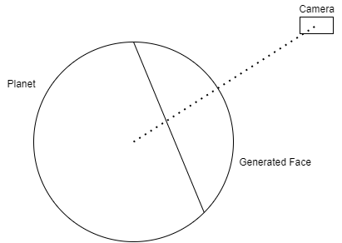
Mesh Generation
Notes:
This standalone was good, but requires some work
Would always generate the faces you passed into it, the cardinal directions
A way to generate only the visible faces was required
1st iteration
The first method involved calculating whether or not the camera was facing the planet
Used the cameras normal to calculate whether or not it fell within some arbitrary threshold
Still depended on the use of the cardinal vectors
Correct face would not always generate
Gaps would occur
2nd iteration
Generated the face relative to the position of the player
Generated the normal for the face generation every frame
Is the diagram on screen now
Would generate the face directly beath the player at full res, and the 4 surrounding faces at a much lower resolution
This was much more reliable and looked a lot better
Non of the previous issues would occur
This method optimised for LOD as well
Extra notes
Was originally calculated on the cpu in an ienumeator function over several frames
Moved to a new technology that was learned, compute functions

Slide 10
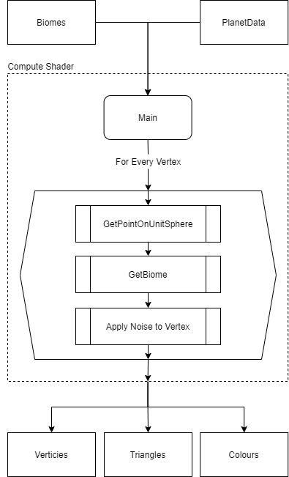
Terrain Generation
Notes:
The basic workflow of this compute shader can be seen on screen now
The next area that was implemented was the terrain generation system, as this is a core component of this shader
Within research the autobiomes paper by fischer et al. was the core inspiration for the system that I wanted to create
This paper detailed a way to create biomes in terrain, to add more variety to regular noise terrain
As you can see on this workflow diagram:
The shader takes in the biome data, and the planet data
Then generates a unit sphere
Then, based off the biome, add noise to the vertex

Slide 11
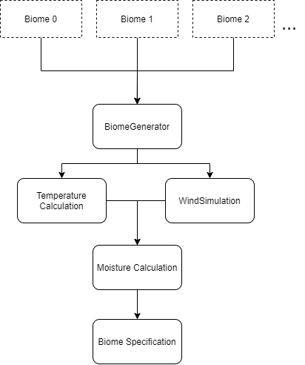
Terrain Generation
Notes:
The biomes as you can see are a core component of the terrain generation
It was decided that this could be precomputed, as it was theorised that it would be to slow for runtime operation
Data was then stored in the BiomeMap,
The biome data, inspired by autobiomes, was calculated in the order as shown above
First the user inputs the biome data, this is stored in scriptabels objects and are easily customisable
This data is then sent to the biomeGenerator class
Weather simulations are then done and the biomes are claisified

Slide 12
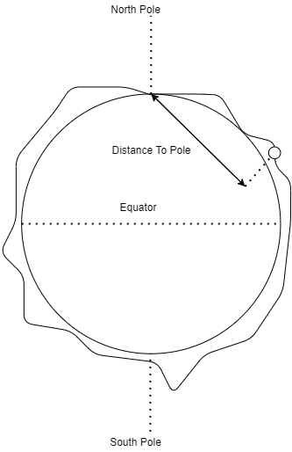
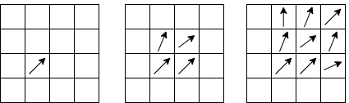
Terrain Generation
Notes:
These weather simulations consist of 3 main steps
Temperature simulation
Diagram to the right
Uses the distance to the pole of the planet, and its relative altitude
These values are multiplied by a user defined modifier to prefer either the altitude or the distance
The values are then combined and averaged to offer a 0-1 temp value
Wind simulation
1st iteration
Attemped a fluid dynamics wind simulation, as stated in the paper
Is the graph to the left
Randomly generated wind origin points aross a map,
These points would then propgate across the surface, simulating wind
Although realistic was difficult to implement
Wind values were exponential
Issues with distribution and performance
This method scrapped
2nd iteration
Much Simpler
Used a simplex noise function to generate sudo random values
Not realistic but would work for biome distinction
Much more efficient
Moisture simulation
Used as the way to define the biomes in auto biomes
Originally planned to use a similar approach to the wind
Using the wind data to diffuse and spread moisture, using the temperature values as well
Instead a calculation was done, the colder and higher the wind, the higher the moiseter and vice versa

Slide 13

Atmospheric Rendering
Notes:
The next thing added was the atmosphere
Research was done into existing approaches, as it has been well researched
Came across sebastin lagues implemtation
Complete unity implmentaion
Identical to the methods decirbed by Schafhitzel and elek
Took his implementation
Issues arose unfortunately
Had to be converted into unit URP
Lots of tweaks had to be made

Slide 14
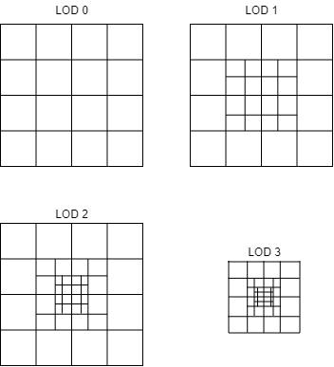
Level of Detail System
Notes:
By far the most difficult component
Unfortnatley was not implemented
The First attempts was geometric clipmapping
Used the concepts behind texture clipmaps and applied them to mesh’s
Generated the terrain around the player, and lowered the resolution the further out the camera was
Desinged for heightmaps, but could be reworked for procedural
Promising, but had issues integrating it with unity’s mesh system, had to be simplified
The second attemps was similar, but a lot more simple
Simply generated the mesh around the player, then made consentric boreders at lower resolution
Is the approach seen on screen now
The higher the lod, the higher the resolution of the mesh
Would also elimineate the outer boreder after a point to lower vertice count
Issues unfortuabtley arose in implmentaion
Calculatuing the border offset
Correct location of mesh
Had to be scrapped

Slide 15
Demonstration
Notes:
The following section features a video demonstration of both how the package works within unity, and quick look at how the end product looks within the provided executable

Slide 16
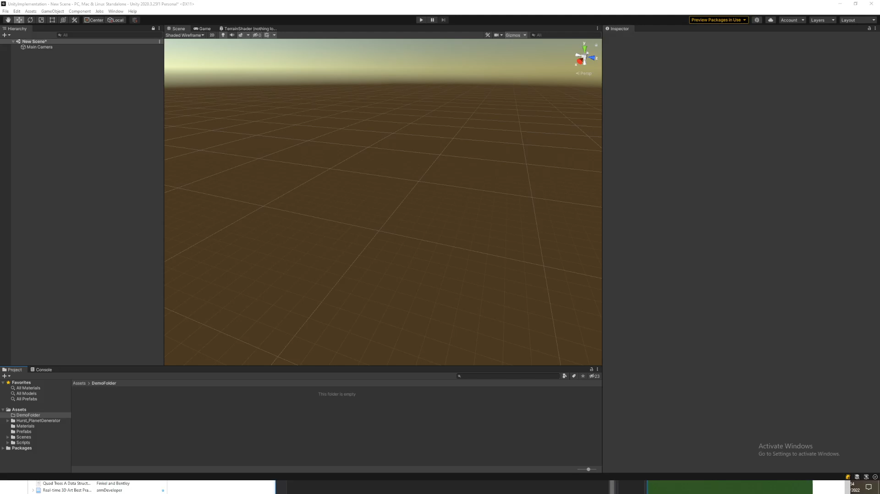
Package gen demo here

Slide 17

Game demo here

Slide 18
Evaluation
Notes:
This section details the evaluation that was done into the major components of this project.
These include
The mesh’s quality
The performance of the mesh generation process, and factors that may effect it
Ther performance of the biome system, both effiecny and quality
An overall evaluation if I have reached the goals I set ou to accomplish

Slide 19
Mesh Evaluation
Notes:
First area that was investigated was the perfomacne of the mesh generator
Important because it runs every frame
Needed to see the point at which it becomes unplayable (24fps), and see its memory useage (pcs average 8gb ram)
Memory useage was tested first using the unity profiler
AS seen on the graph, this process is not very memory efficient,
Lowest resolution tested used more than 4gb ram
Follows a linear trend from there,
Predicited to exceed 8gb of useage after a resolution of 170
FPS was then tested also
Frame rate was very high at lower resolution
Also followed a linear trend downwards
Reached unpkayabel at around 115 resolution
Both these factors highlighted the need for an LOD system
LOD would limit the geometry and number of vertices\
Increseing fps and decreaing ram usage

Slide 20
Mesh Evaluation
Notes:
One additiaol test was done on the mesh
To see if unity had issues with meshes of increasing sizes, the raius was increased to see if that was a factor oin fps
Although the graph shows an upawards trend, it is still within margin of error
Was concluded there was not correlation and the radisu had no effect

Slide 21
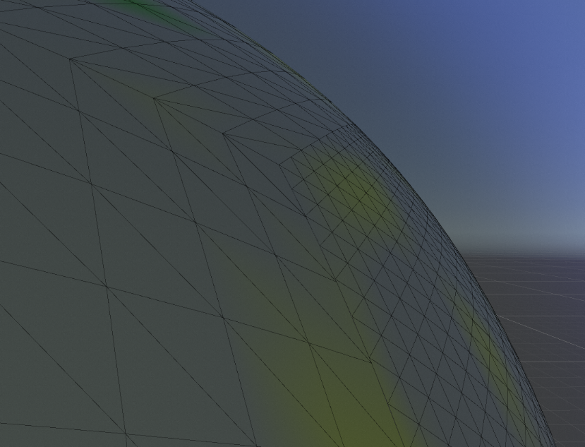
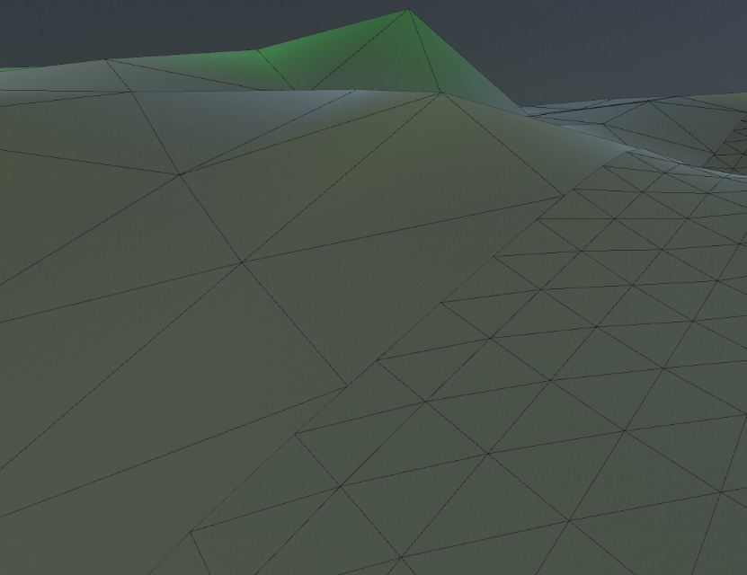
Mesh Evaluation
Notes:
A visual evaluation was then conducted
An inspection of how the mesh deforms, as well as the vertex distribution was done
As you can see vertex distrobutoin is very good, and is consistent and unifor,
Mesh defomation is also good
No seams alogn the different resoltuon faces
Even when different hieghts meet, the resolution and vertices are consistent and there are no breaks in the mesh

Slide 22
Terrain Evaluation
Notes:
Another major factor that would increase how long it would take to generate was the biome map
Large process, needed to justify to making in execute before runtime
As can be seen, it is an exponential issue

Slide 23
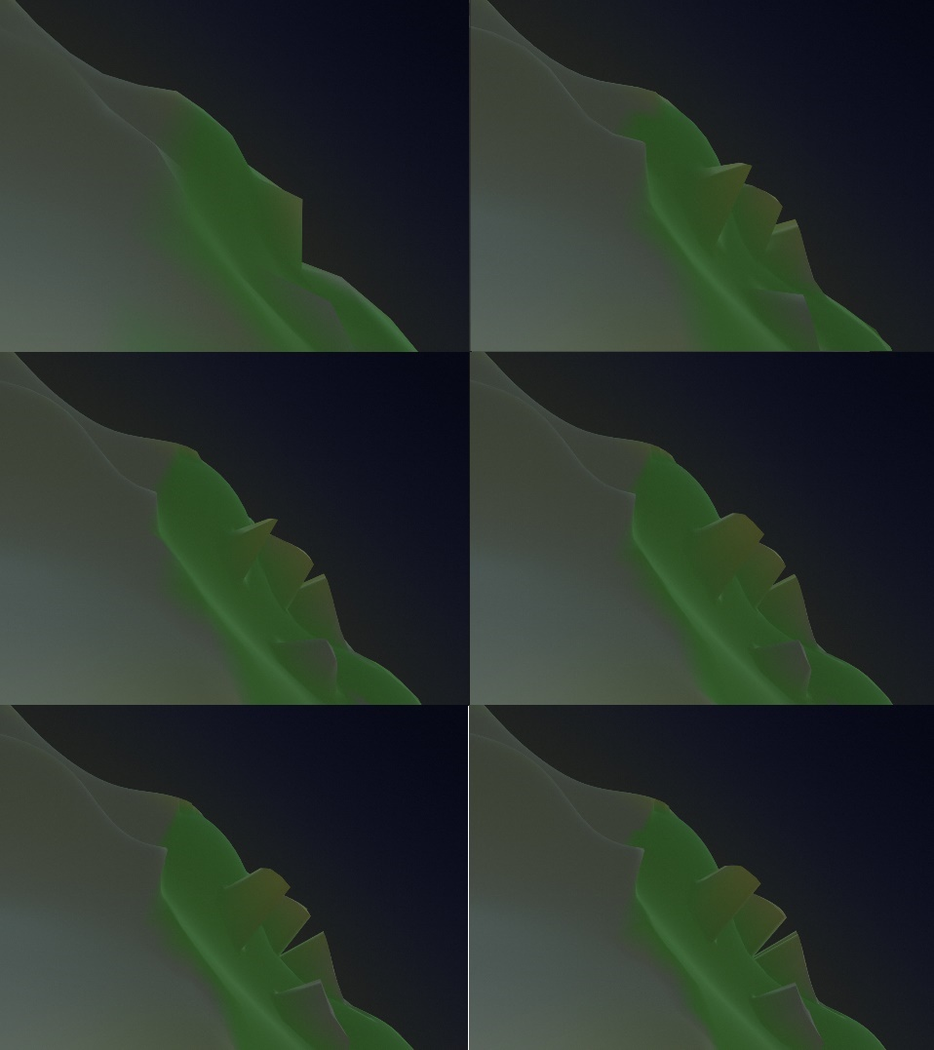
Terrain Evaluation
Notes:
Look at the visuals was requreid
Evaluate the generated terrain, at varying resolutions
Higher the resolution, the more terrain features are created
As seen at the beining of the presntation, similar to how the terrain looks in elite dangerous

Slide 24
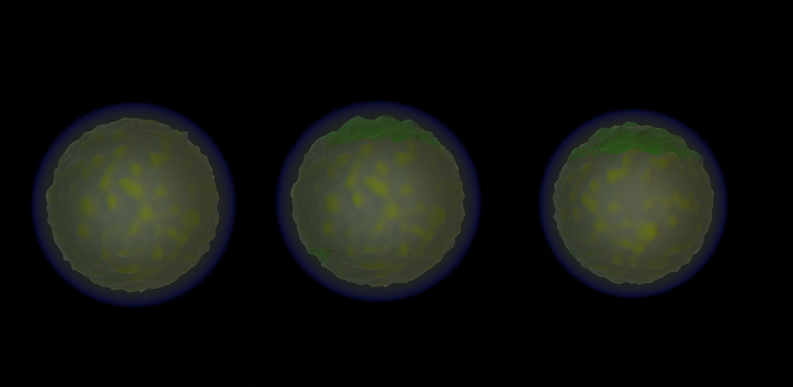
Terrain Evaluation
Notes:
The affect of bioems was then anylsed
Descibre how each time a biome is added, it adds further refinement and variatoipn to the terrain

Slide 25
Conclusion
Notes:
Skills learned, and successes
LOD is definitely needed
Big refinement to biomes
Convert to a no completely procedural approach

Slide 26
References
armDeveloper, 2022. Real-time 3D Art Best Practices: Geometry [online]. armDeveloper. Available from: https://developer.arm.com/documentation/102448/0100/Triangle-and-polygon-usage [Accessed 12 Apr 2022].
Becher, M., Krone, M., Reina, G. and Ertl, T., 2017. Feature-based volumetric terrain generation. In: Proceedings of the 21st ACM SIGGRAPH Symposium on Interactive 3D Graphics and Games [online]. Presented at the I3D ’17: Symposium on Interactive 3D Graphics and Games, San Francisco California: ACM, 1–9. Available from: https://dl.acm.org/doi/10.1145/3023368.3023383 [Accessed 20 Apr 2022].
Bonet, R., 2020. Are You Pushing Too Many Vertices to Your GPU? Careful There... [online]. GameDev.net. Available from: https://gamedev.net/tutorials/programming/general-and-gameplay-programming/are-you-pushing-too-many-vertices-to-your-gpu-careful-there-r5411 [Accessed 19 May 2022].
Building Worlds in No Man’s Sky Using Math(s), 2017. Available from: https://www.youtube.com/watch?v=C9RyEiEzMiU [Accessed 19 Mar 2022].
Cabot, S., 2020. Exploring the Myth: Calculating Square Root is Expensive [online]. DEV Community. Available from: https://dev.to/iamscottcab/exploring-the-myth-calculating-square-root-is-expensive-44ka [Accessed 7 May 2022].
Cajaraville, O. S., 2019. Four Ways to Create a Mesh for a Sphere. Medium [online]. Available from: https://medium.com/@oscarsc/four-ways-to-create-a-mesh-for-a-sphere-d7956b825db4 [Accessed 2 Feb 2022].
Coding Adventure: Atmosphere, 2020. Available from: https://www.youtube.com/watch?v=DxfEbulyFcY [Accessed 13 May 2022].
Coding Adventure: Procedural Moons and Planets, 2020. Available from: https://www.youtube.com/watch?v=lctXaT9pxA0 [Accessed 10 Feb 2022].
Elek, O., 2009. Rendering Parametrizable Planetary Atmospheres with Multiple Scattering in Real-Time, 8.
Finkel, R. and Bentley, J. L., 1974. Quad Trees A Data Structure for Retrieval on Composite Keys. [online], 4. Available from: https://www.researchgate.net/publication/220197855_Quad_Trees_A_Data_Structure_for_Retrieval_on_Composite_Keys [Accessed 19 Apr 2022].
Fischer, R., Dittmann, P., Weller, R. and Zachmann, G., 2020. AutoBiomes: procedural generation of multi-biome landscapes. The Visual Computer, 36 (10–12), 2263–2272.
HadΣs, 2022. Steam Community :: Guide :: Elite Dangerous: Horizons Planet Landing/Exploration [online]. Steam. Available from: https://steamcommunity.com/sharedfiles/filedetails/?id=578825422 [Accessed 22 May 2022].

Slide 27
References
Heaven, D., 2016. When infinity gets boring: What went wrong with No Man’s Sky [online]. New Scientist. Available from: https://www.newscientist.com/article/2104873-when-infinity-gets-boring-what-went-wrong-with-no-mans-sky/ [Accessed 13 May 2022].
Hohl, 2022. How Big Are The Planets In No Man’s Sky? [online]. AllGamers. Available from: https://ag.hyperxgaming.com/article/1805/how-big-are-the-planets-in-no-mans-sky [Accessed 25 Apr 2022].
Hoppe, H., 1998. Smooth view-dependent level-of-detail control and its application to terrain rendering. In: Proceedings Visualization ’98 (Cat. No.98CB36276). Presented at the Proceedings Visualization ’98 (Cat. No.98CB36276), 35–42.
Hoppe, H., 2004. Geometry Clipmaps, 8.
Keinert, B., Innmann, M., Sänger, M. and Stamminger, M., 2015. Spherical fibonacci mapping. ACM Transactions on Graphics, 34 (6), 1–7.
Kumar, J. M., Herger, M. and Dam, R. F., 2022. Bartle’s Player Types for Gamification [online]. The Interaction Design Foundation. Available from: https://www.interaction-design.org/literature/article/bartle-s-player-types-for-gamification [Accessed 25 Apr 2022].
Lagae, A., Lefebvre, S., Cook, R., DeRose, T., Drettakis, G., Ebert, D. s., Lewis, J. p., Perlin, K. and Zwicker, M., 2010. A Survey of Procedural Noise Functions. Computer Graphics Forum, 29 (8), 2579–2600.
Lee, J., 2015. No Man’s Sky and the Future of Procedural Games [online]. MUO. Available from: https://www.makeuseof.com/tag/no-mans-sky-future-procedural-games/ [Accessed 25 Apr 2022].
Logical Increments, 2021. Information About Frame Rate [online]. Logical Increments. Available from: https://logicalincrements.com/articles/framerate [Accessed 19 May 2022].
Mega Voxels, 2019. What is a voxel? [online]. Available from: https://www.megavoxels.com/2019/08/what-is-voxel.html [Accessed 4 Mar 2022].
Michelic, F., 2019. Real-Time Rendering of Procedurally Generated Planets, 8.
Milne, C., 2019. At the end of a five-month Elite Dangerous expedition, I looked into the Abyss. Rock, Paper, Shotgun [online]. Available from: https://www.rockpapershotgun.com/elite-dangerous-expedition-diary-part-3 [Accessed 19 May 2022].

Slide 28
References
Montgomery, N., 2008. Floating Point error – what, why and how to!! In: [online]. Presented at the PHUSE 2008, PHUSE, 20. Available from: https://www.lexjansen.com/phuse/2008/cs/CS08.pdf [Accessed 25 Apr 2022].
NASA, 2022. Imagine the Universe! [online]. Available from: https://imagine.gsfc.nasa.gov/features/cosmic/earth_info.html [Accessed 24 Apr 2022].
Newman, T. S. and Yi, H., 2006. A survey of the marching cubes algorithm. Computers & Graphics, 30 (5), 854–879.
O’Neil, 2022. A Real-Time Procedural Universe, Part Three: Matters of Scale [online]. Available from: https://www.gamasutra.com/view/feature/131393/a_realtime_procedural_universe_.php [Accessed 4 Feb 2022].
Patel, A., 2022a. Delaunay+Voronoi on a sphere [online]. Available from: https://www.redblobgames.com/x/1842-delaunay-voronoi-sphere/ [Accessed 4 Feb 2022].
Patel, A., 2022b. Procedural map generation on a sphere [online]. Available from: https://www.redblobgames.com/x/1843-planet-generation/ [Accessed 4 Feb 2022].
Rose, T. and Bakaoukas, A., 2016. Algorithms and Approaches for Procedural Terrain Generation - A Brief Review of Current Techniques. In: . 1–2.
Savage, M., 2017. Geometry clipmaps: simple terrain rendering with level of detail - mikejsavage.co.uk [online]. mikejsavage.co.uk. Available from: https://mikejsavage.co.uk/blog/geometry-clipmaps.html [Accessed 12 Apr 2022].
Schafhitzel, T., Falk, M. and Ertl, T., 2007. Real-Time Rendering of Planets with Atmospheres, 8.
Schneider, J., 2006. GPU-Friendly High-Quality Terrain Rendering. Journal of WSCG, 8.
Scratchapixel, 2022. Value Noise and Procedural Patterns: Part 1 [online]. Scratchapixel. Available from: https://www.scratchapixel.com//lessons/procedural-generation-virtual-worlds/procedural-patterns-noise-part-1 [Accessed 18 May 2022].
Sears, D., 2022. Why are planets round? [online]. Scientific American. Available from: https://www.scientificamerican.com/article/why-are-planets-round/ [Accessed 2 Mar 2022].
Shankar, R., 2021. Difference Between float vs double Data Types [Updated] [online]. Hackr.io. Available from: https://hackr.io/blog/float-vs-double [Accessed 18 May 2022].

Slide 29
References
Sin, Z. P. T. and Ng, P. H. F., 2018. Planetary Marching Cubes: A Marching Cubes Algorithm for Spherical Space. In: Proceedings of the 2018 the 2nd International Conference on Video and Image Processing [online]. Presented at the ICVIP 2018: 2018 the 2nd International Conference on Video and Image Processing, Hong Kong Hong Kong: ACM, 89–94. Available from: https://dl.acm.org/doi/10.1145/3301506.3301522 [Accessed 21 Feb 2022].
SpaceGamerUK, 2017. Frontier Is Missing the Point With Elite: Dangerous ‘The Commanders’ Addition [online]. Game Skinny. Available from: https://www.gameskinny.com/nprjv/frontier-is-missing-the-point-with-elite-dangerous-the-commanders-addition [Accessed 18 May 2022].
Stam, J., 2003. Real-Time Fluid Dynamics for Games, 17.
Unite 2013 - Building a new universe in Kerbal Space Program, 2013. Available from: https://www.youtube.com/watch?v=mXTxQko-JH0 [Accessed 10 Feb 2022].
Vitacion, R. J. and Liu, L., 2019. Procedural Generation of 3D Planetary-Scale Terrains. In: 2019 IEEE International Conference on Space Mission Challenges for Information Technology (SMC-IT). Presented at the 2019 IEEE International Conference on Space Mission Challenges for Information Technology (SMC-IT), 70–77.
Witman, E., 2022. How much RAM do you need? How to tell and when you should upgrade your computer storage [online]. Business Insider. Available from: https://www.businessinsider.com/how-much-ram-do-i-need [Accessed 19 May 2022].

